Slide 1
Story Board Overview
Module Name: | Duration :
Learning Objectives :
Topics Covered:
Tool used:
Inter Personal Skills
8 minutes (approx.)
To improve trust levels between you and your team members
To improve interpersonal skills
Learn to make deposits and reduce withdrawals of emotions
Learn how to give Positive Strokes
Build effective relationship with the team members
Interpersonal Skills and its importance
Impact in the absence of Interpersonal skills
Ways to improve Interpersonal skills
Emotional Bank Account
Benefits of High Deposits in Emotional Bank Account
PowerPoint Presentation / Storyline 360

Slide 2
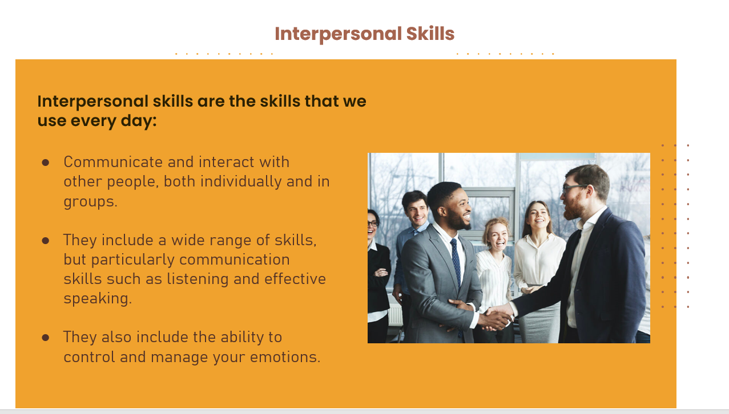
Slide Title: Inter personal skills
Audio Narration | Slide Mockup
Text Hello Everyone ! Today we will learn about Interpersonal Skills. To begin with : Let us first know, What actually is the Interpersonal skills? Communicate and interact with other people, both individually and in groups. They include a wide range of skills, but particularly communication skills such as listening and effective speaking. They also include the ability to control and manage your emotions.
Model Used : ADDIE (Analyze)
Pre launch – Learning objectives and testing the learner’s previous knowledge Post Launch – Audience – Adult learners

Slide 3
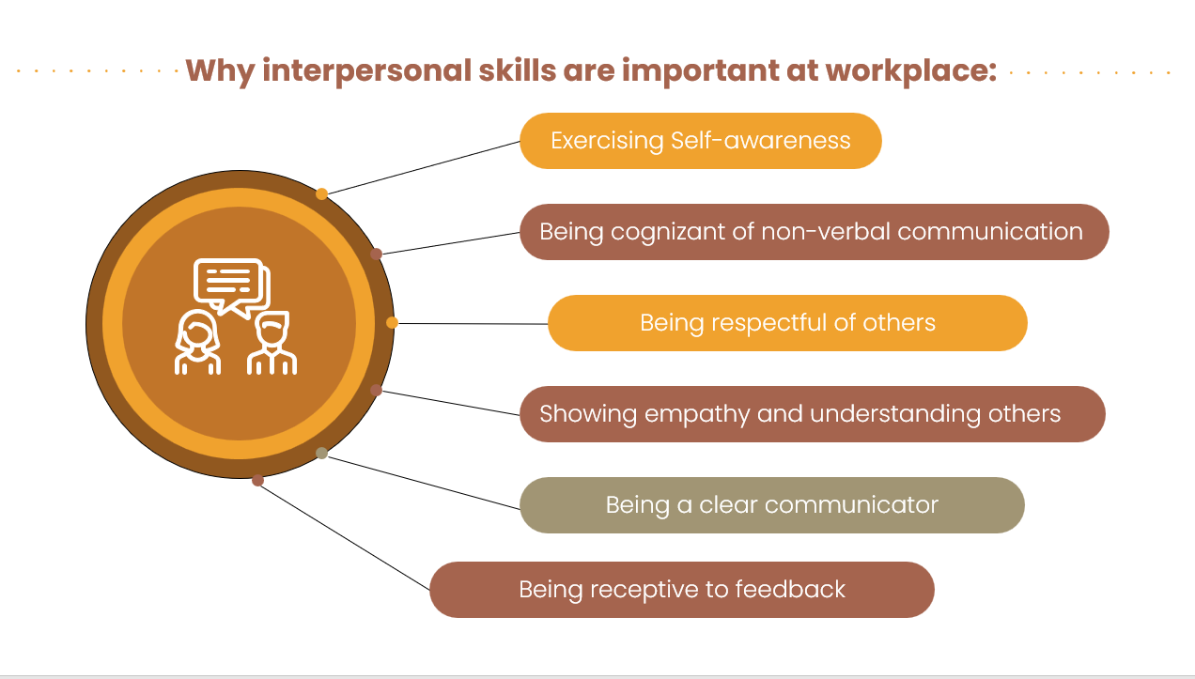
Slide Title: Inter personal skills
Audio Narration | Slide Mockup
However, One should also understand the importance of Interpersonal skills like:
Model Used : ADDIE (Design)
Pre launch – The information is sequenced one after the other Post launch - The learns will be able to develop an understanding of the importance od Interpersonal Skills.
Exercising Self-awareness
Being cognizant of non-verbal communication
Being respectful of others
Showing empathy and understanding others
Being a clear communicator
Being receptive to feedback

Slide 4
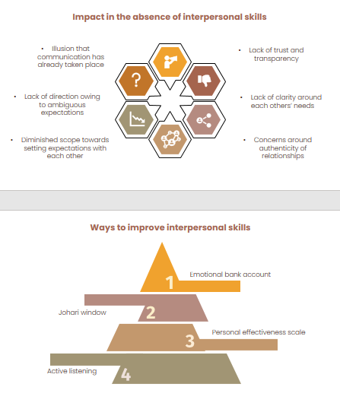
Slide Title: Inter personal skills
Audio Narration | Slide Mockup
As we have all seen and understood the importance and high need of Interpersonal skills, we must also be aware of the absence of the same:
Model Used : ADDIE (Develop)
Pre launch – The learner is fully aware of the importance of the Interpersonal skills Post launch – The learner now understands about the impact of the absence of Interpersonal skills and will be made aware about the ways to improve it
Illusion that communication has already taken place
Lack of trust and transparency
Lack of clarity around each others’ needs
Concerns around authenticity of relationships
Diminished scope towards setting expectations with each other
Lack of direction owing to ambiguous expectations

Slide 5
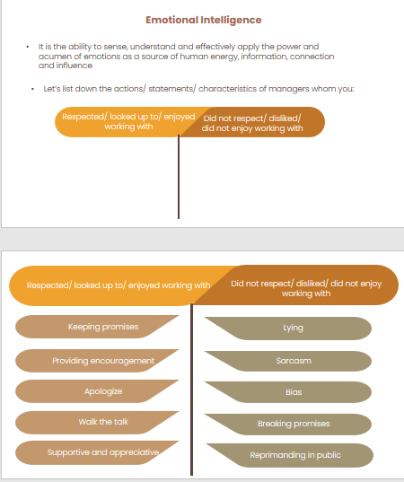
Slide Title : Inter personal skills
Audio Narration | Slide Mockup
As we saw earlier there are 4 different ways to improve the Interpersonal skills. First, we shall begin with Emotional Bank account. Which is closely associated with Emotional Intelligence - It is the ability to sense, understand and effectively apply the power and acumen of emotions as a source of human energy, information, connection and influence Lets start with listing down the actions/ statements/ characteristics of managers whom you: Respected/ looked up to/ enjoyed working with Did not respect/ disliked/ did not enjoy working with
Model Used : ADDIE (Implement)
Pre launch - The learner is aware about 4 different ways to improve interpersonal skills Post launch – The learner is made aware about the implementation of Emotional Intelligence by conducting an activity. Furter goes on with explaining the Emotional Bank account.

Slide 6
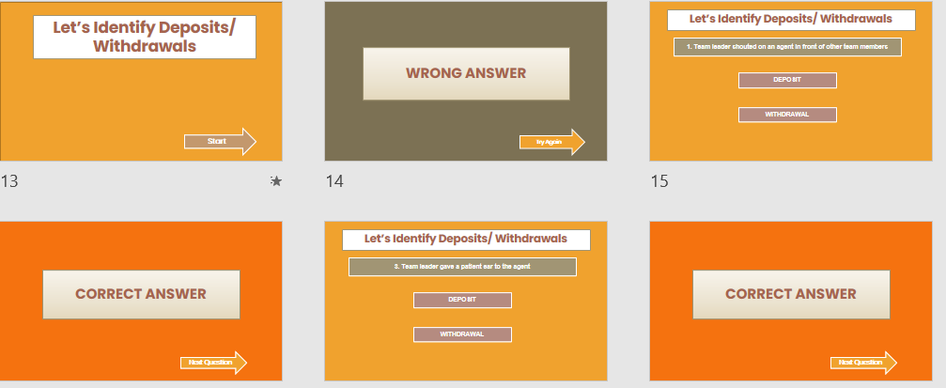
Slide Title : Inter personal skills
Audio Narration | Slide Mockup
So far we know the Emotional Bank account is a mixture of Deposit + Withdrawal = TRUST Therefore, to test this we shall solve a small quiz. (The learner is supposed to click on the start button to begin the quiz and go ahead accordingly. On selection of Correct answer the arrow displays the arrow – NEXT QUESTION and on the select of Incorrect answer the arrow displays the arrow – TRY AGAIN)
Model Used : ADDIE (Evaluate)
Pre launch – The Learner has gained the knowledge so far about the Emotional Intelligence Post launch – The learners gained knowledge is put to test.

